Slide 1

Basics of Neural Network Programming
A note on python/
numpy vectors
deeplearning.ai

Slide 2
Python Demo -1
Broadcasting is a strength in a sense that it gives great flexibility & at the same time it is a weakness since with this broadcasting we can introduce bugs.
A lot can be done in a single line of code.
However subtle bugs can be introduced due to broadcasting.
For example, if we add a column vector to a row vector we might expect to get an error where as we might get a matrix due to broadcasting.
Some students get hard to define bugs, we need to know these tricks.

Slide 3
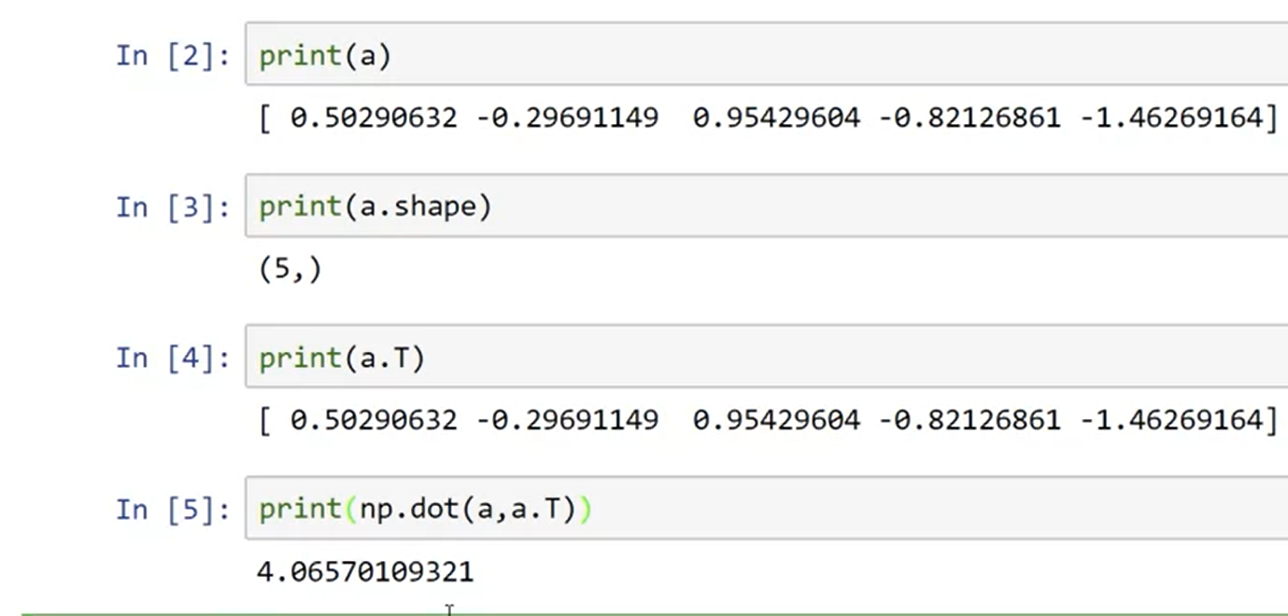
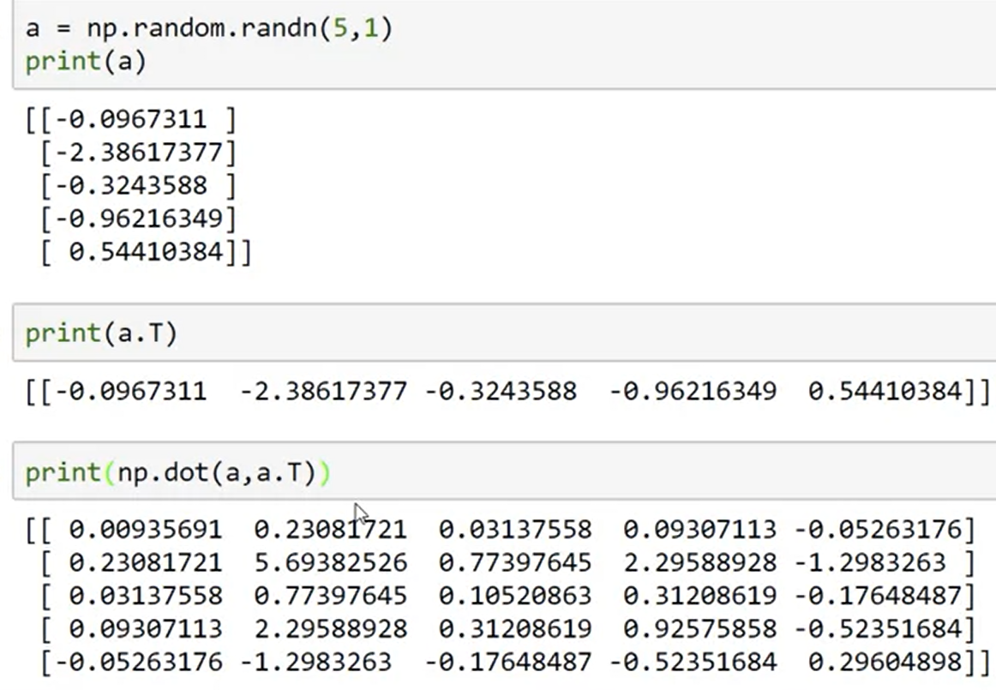
Python Demo -2
Here in this case, we get a rank 1 array it. It is neither a row vector nor a column vector
We take its transpose we get the same thing. And we may expect a matrix when multiplying it with transpose
Andrew recommend not to use these kind of data structures.
Instead we should set write a proper order in these operations.
Here, when we got 5 rows with one column & its transpose is proper i.e. 1 row & 5 columns.

Slide 4
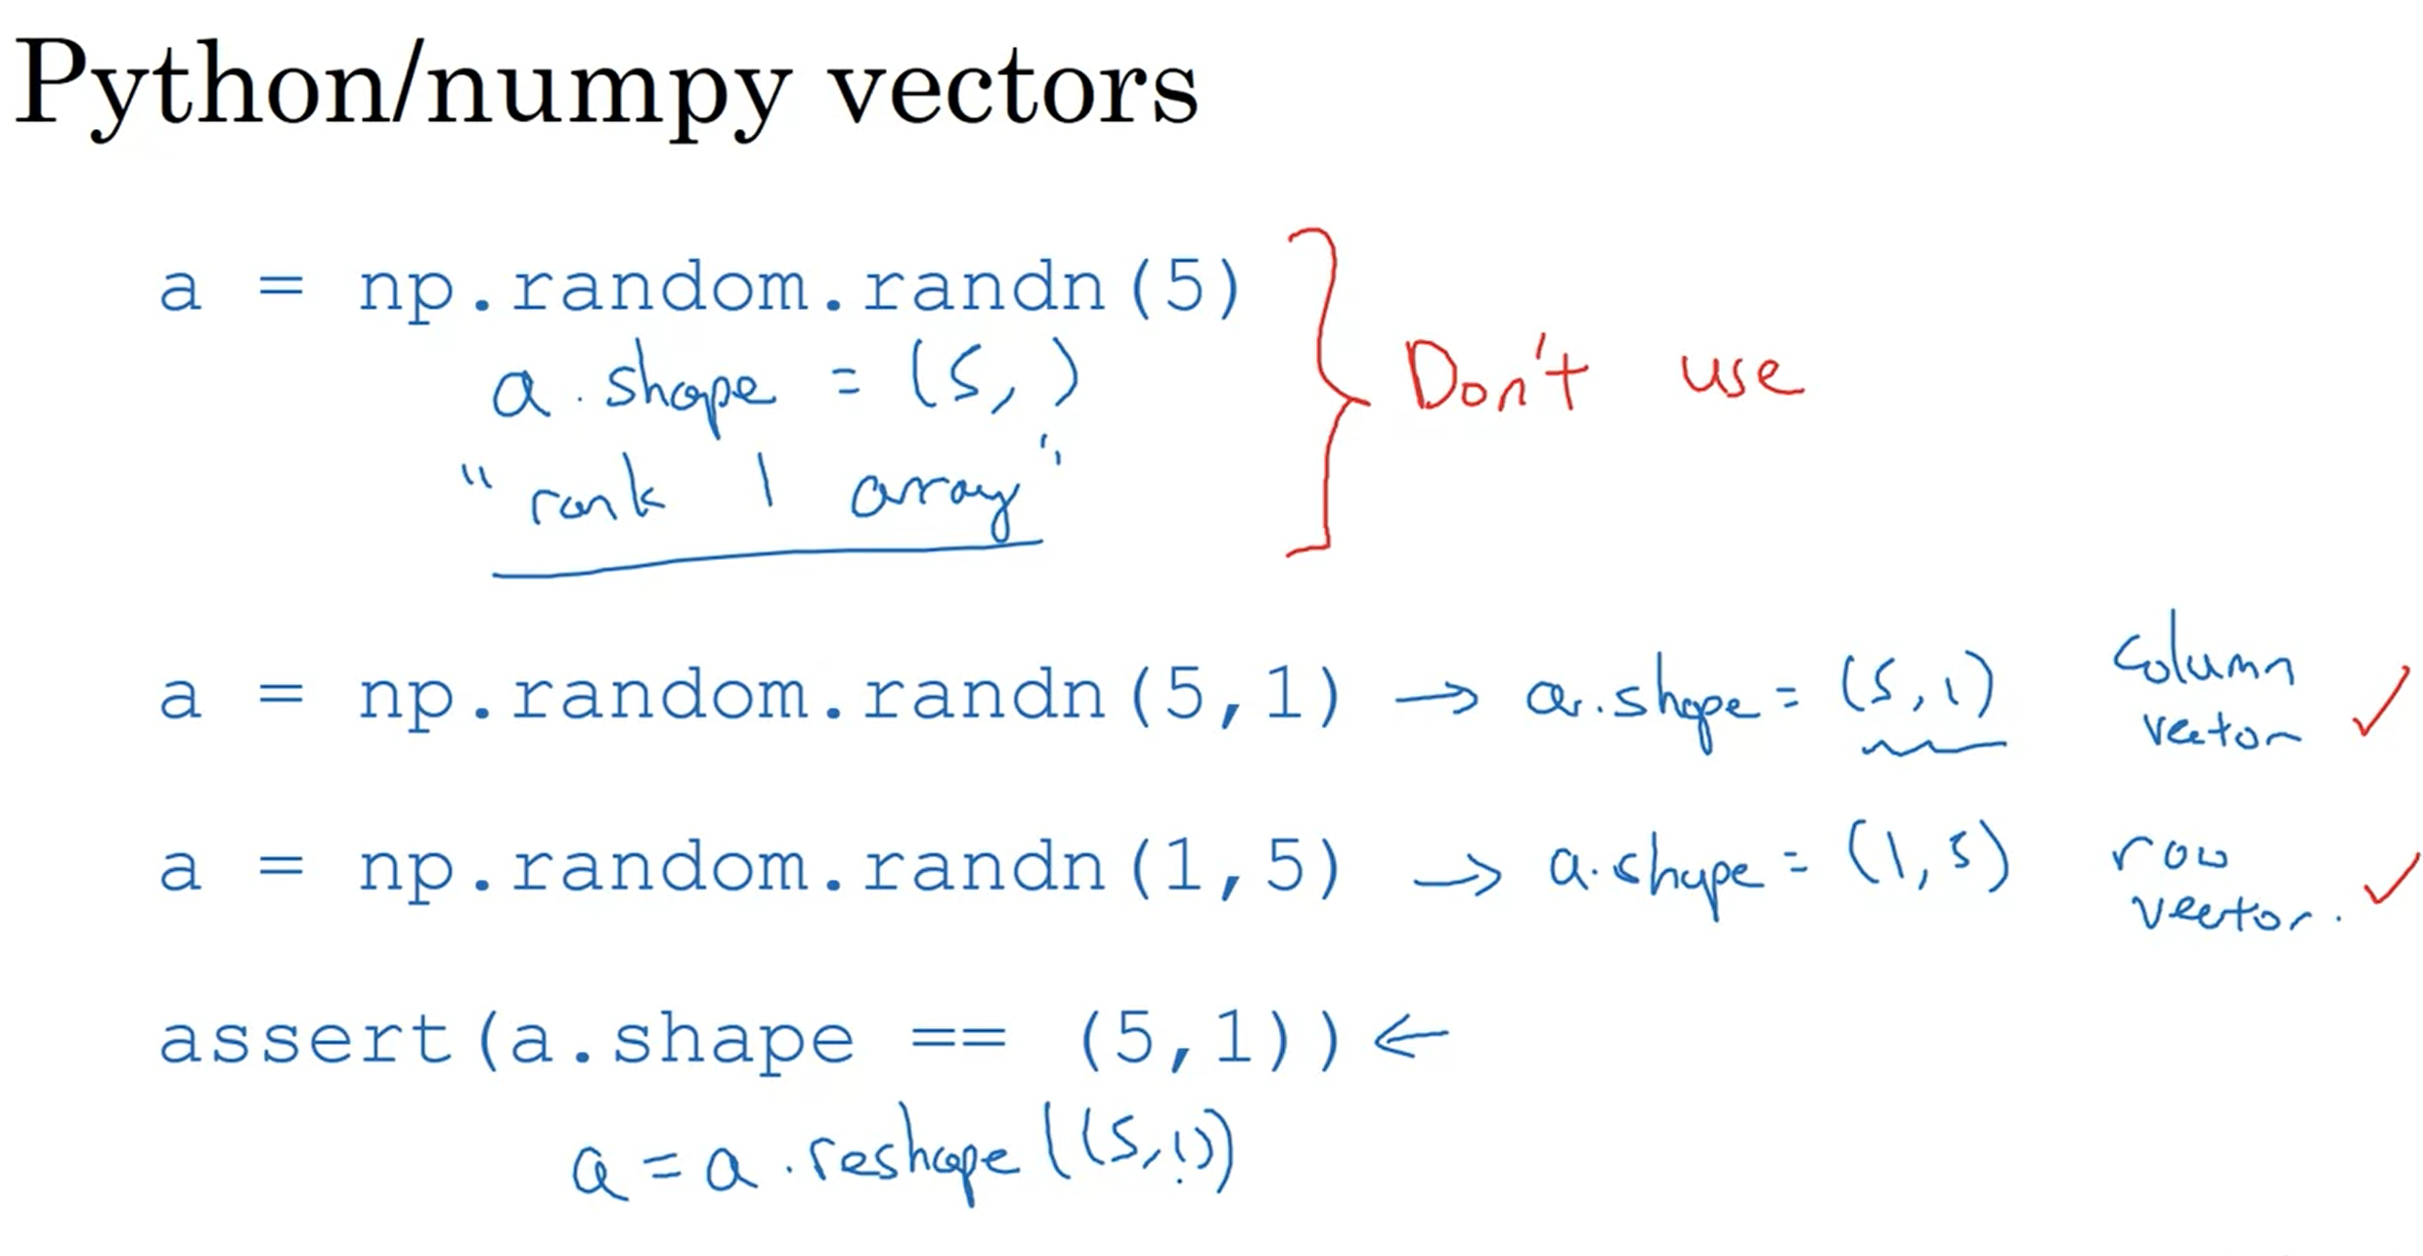
Lecture
Notes:
If you have a rank 1 array than reshape iut
Always use column vectors or row vectors.
Throw a lot of assertion statements.

Slide 5
Python / numpy vectors
import numpy as np
a = np.random.randn(5)
a = np.random.randn((5,1))
a = np.random.randn((1,5))
assert(a.shape = (5,1))
Notes:
The first command created a funny thing 5,1 which is not a row vector or column vector it behaves funny.
Commit either to make a column vector or a row vector.

